Slide 1
Memory Model of A Program, Methods
Overview
Memory Model of JVM
  Method Area
  Heap
  Stack

Slide 2
Memory Model of JVM
So far we have learnt that to execute a java program, it is first compiled into bytecode, then invoke the JVM which loads and execute it.
However, to have a clearer understanding of how Java programs execute, we need to take a closer look at the memory model of JVM.
The JVM divides the memory into three main areas, as shown by the diagram below:
Method Area
Stack
Heap

Slide 3
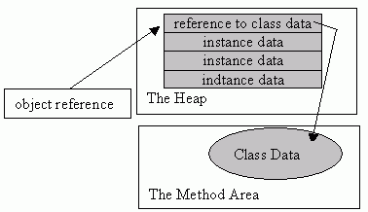
Memory Model of JVM (cont’d)
When a class file is loaded, the JVM extracts the following information and store them in the method area:
  The bytecode for each method in the class
  The class variables (static variables)
  Class information – modifies, etc
  Methods’ information – modifies, return type, etc
The Heap
This is where objects are created. Memory is allocated for each of the instance variables of the object.
Also a reference to the method area containing the code for the methods of the object is stored with the data for the object.
`

Slide 4
Memory Model of JVM (cont’d)
Stack
At any particular point in the life-time of an application, only one method can execute. Such method is called current method.
A method may call another method, which may in turn call another, etc.
To keep track of the order from one method call to another, the stack memory area is used.
This is achieved by creating a stack frame for the current method in the stack.
The stack frame (also called activation record) contain the following information:
Local variables and parameters of the method
References to objects created by the method
Return address and return value of the method
If the current method calls another method, another frame is created for that method and push onto the stack – that method then becomes the current.
On exit from the current method, its frame is popped off the stack and discarded
Thus the value of local variables exists in memory only as long as the method executes.

Slide 5
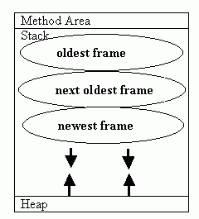
Memory Model of JVM (cont’d)
‘

